Slide 1
Introduction to Computation
Fan Cheng Shanghai Jiao Tong University
http://www.cs.sjtu.edu.cn/~chengfan/
chengfan@sjtu.edu.cn
Autumn, 2020
Notes:
Numbers, floating numbers, string, mathematical expressions, print()

Slide 2

Involved Issues
无他，唯手熟尔

Slide 3
递归与循环
递归调用其实是个循环过程
递归函数调用需要额外时间、空间开销：传递参数，保存中间值，切换函数
循环比函数递归更高效
递归函数更容易写，更符合人的思维模式
递归函数是把复杂问题转化为简单问题
初学者滥用递归：能用递归的地方一律递归
循环是从简单条件出发一步步构造复杂情况
Life is short, use python: Python给大家很多便利，更符合人的思维
计算机的思维：0/1
你只能用“三角形盖房子”
程序员来适应计算机
任何程序都可以用赋值、逻辑语句、判断语句、循环语句、跳转语句实现
难点：循环语句
while是一个复杂过程
如何通过设计一个循环来完成一个复杂的功能

Slide 4

while: 状态更新
判断状态条件
进行操作
修改状态

Slide 5
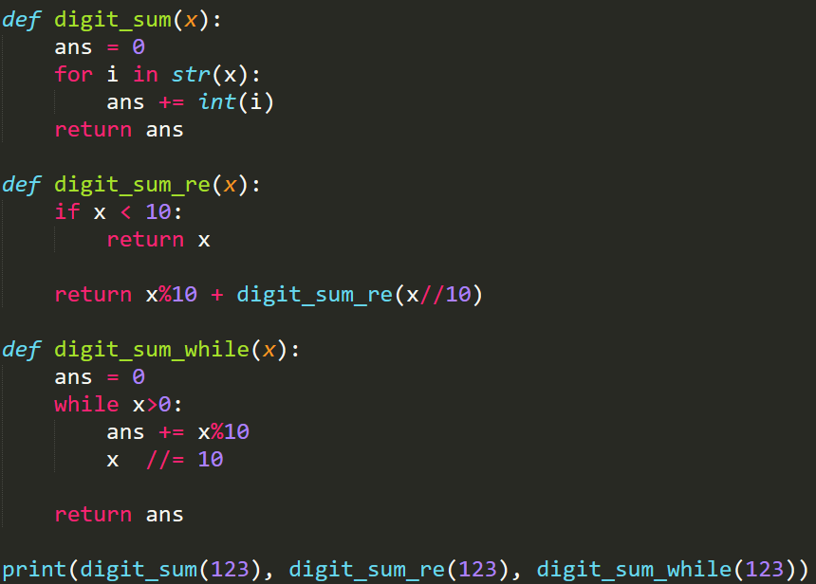

判断状态条件
进行操作
修改状态
递归与循环
计算一个数各位数字的和
while: 必须明确地想清楚整个变化过程, 从i到i+1(递归函数自动完成)
并不是所有的递归都可以很轻松地用while写

Slide 6
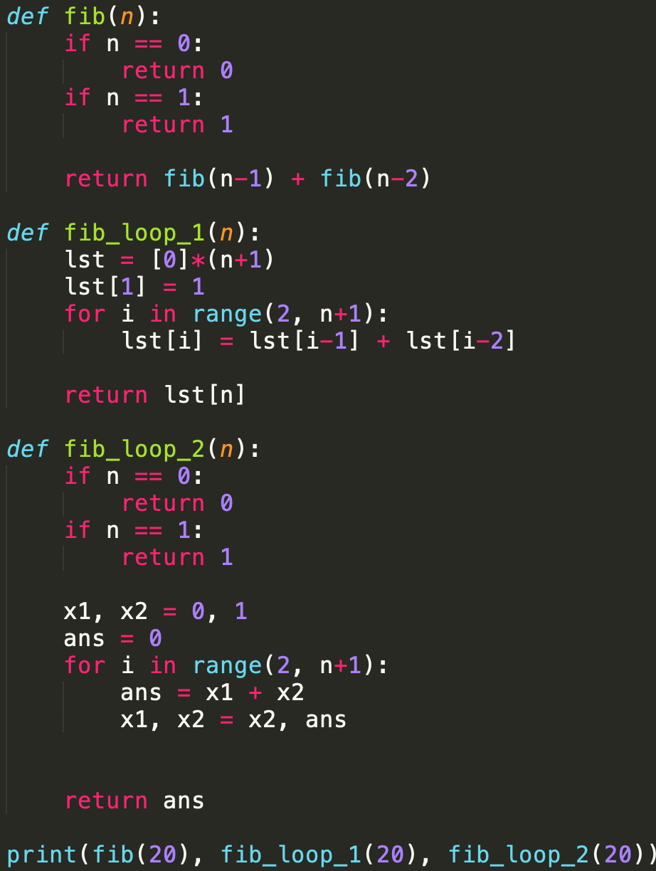

递归与循环
判断状态条件
进行操作
修改状态
计算Fibonacci序列第n项
while: 必须明确地想清楚整个变化过程, 从i到i+1(递归函数自动完成)
并不是所有的递归都可以很轻松地用while写

Slide 7
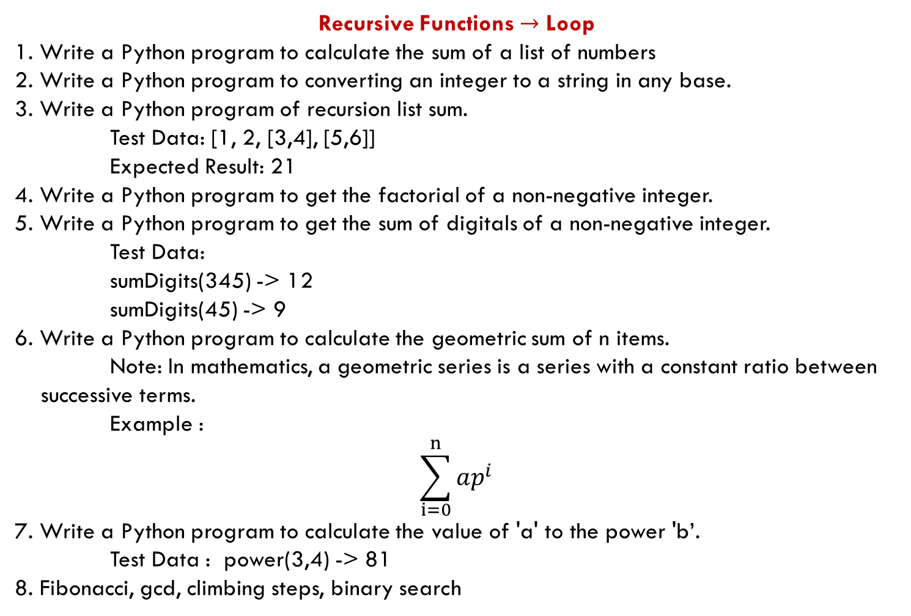
Recursive Functions $→$ Loop
1. Write a Python program to calculate the sum of a list of numbers
2. Write a Python program to converting an integer to a string in any base.
3. Write a Python program of recursion list sum.
Test Data: [1, 2, [3,4], [5,6]]
Expected Result: 21
4. Write a Python program to get the factorial of a non-negative integer.
5. Write a Python program to get the sum of digitals of a non-negative integer.
Test Data:
sumDigits(345) -> 12
sumDigits(45) -> 9
6. Write a Python program to calculate the geometric sum of n items. Note: In mathematics, a geometric series is a series with a constant ratio between
successive terms. Example :
$$\sum_{i=0}^{n}{ap^{i}}$$
7. Write a Python program to calculate the value of 'a' to the power 'b’.
Test Data : power(3,4) -> 81
8. Fibonacci, gcd, climbing steps, binary search

Slide 8
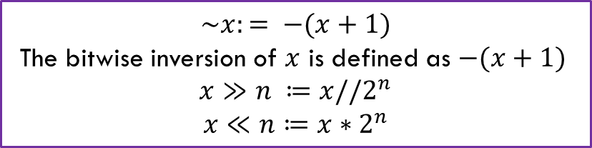
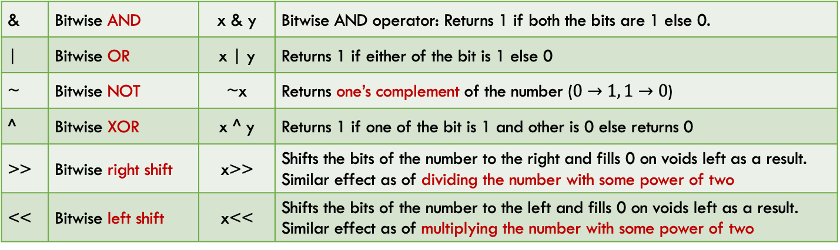
Bitwise Operator
In Python, bitwise operators are used to perform bitwise calculations on integers
The integers are first converted into binary and then operations are performed on bit by bit, hence the name bitwise operators
Then the result is returned in decimal format
& | Bitwise AND | x & y | Bitwise AND operator: Returns 1 if both the bits are 1 else 0.
| | Bitwise OR | x | y | Returns 1 if either of the bit is 1 else 0
~ | Bitwise NOT | ~x | Returns one’s complement of the number ($0→1, 1→0$)
^ | Bitwise XOR | x ^ y | Returns 1 if one of the bit is 1 and other is 0 else returns 0
>> | Bitwise right shift | x>> | Shifts the bits of the number to the right and fills 0 on voids left as a result. Similar effect as of dividing the number with some power of two
<< | Bitwise left shift | x<< | Shifts the bits of the number to the left and fills 0 on voids left as a result. Similar effect as of multiplying the number with some power of two
$$\sim x:= −(x+1)$$
The bitwise inversion of $x$ is defined as $−(x+1)$
$$x≫n ≔x//2^{n}$$
$$x≪n≔x∗2^{n}$$

Slide 9
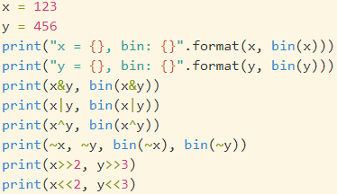
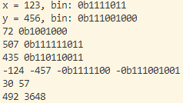
Bitwise Operator
问题：~x为什么要定义位为-1-x
历史原因

Slide 10
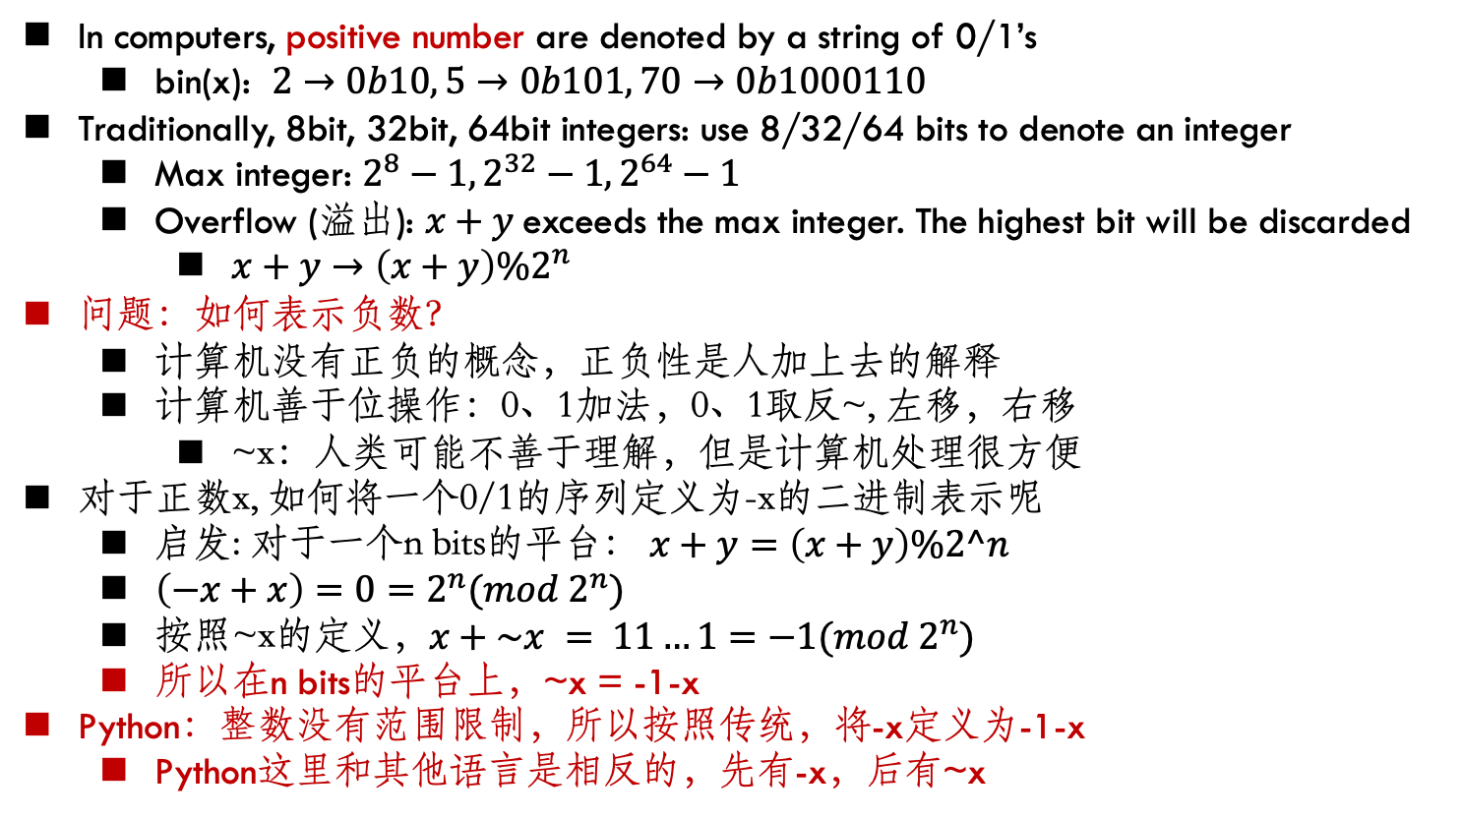
Integer representation
In computers, positive number are denoted by a string of 0/1’s
bin(x): $2→0b10, 5→0b101, 70→0b1000110$
Traditionally, 8bit, 32bit, 64bit integers: use 8/32/64 bits to denote an integer
Max integer: $2^{8}−1, 2^{32}−1, 2^{64}−1$
Overflow (溢出): $x+y$exceeds the max integer. The highest bit will be discarded
$x+y→\left(x+y\right)\%2^{n}$
问题：如何表示负数？
计算机没有正负的概念，正负性是人加上去的解释
计算机善于位操作：0、1加法，0、1取反~, 左移，右移
~x：人类可能不善于理解，但是计算机处理很方便
对于正数x, 如何将一个0/1的序列定义为-x的二进制表示呢
启发: 对于一个n bits的平台： $x+y=\left(x+y\right)\%2^n$
$\left(−x+x\right)=0=2^{n}(mod 2^{n})$
按照~x的定义，$x+\sim x = 11…1=−1(mod 2^{n})$
所以在n bits的平台上，~x = -1-x
Python：整数没有范围限制，所以按照传统，将-x定义为-1-x
Python这里和其他语言是相反的，先有-x，后有~x

Slide 11
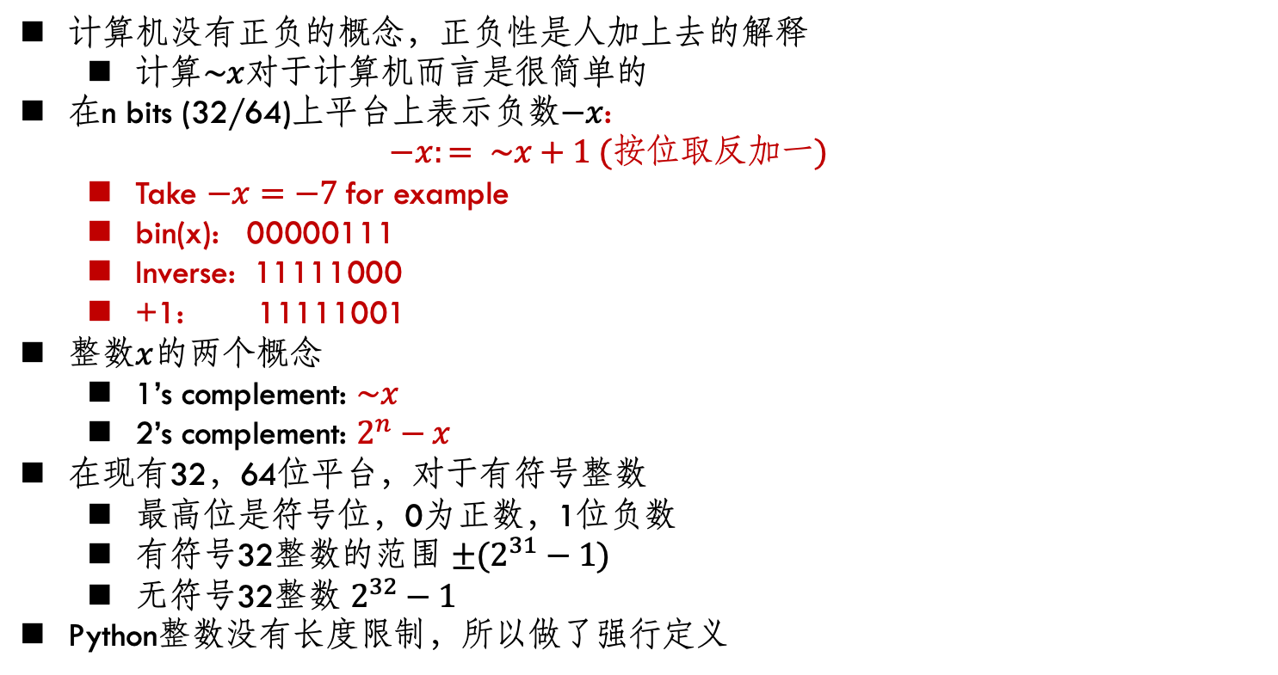
Integer representation
计算机没有正负的概念，正负性是人加上去的解释
计算$\sim x$对于计算机而言是很简单的
在n bits (32/64)上平台上表示负数$−x$:
$$−x:= \sim x+1 (按位取反加一)$$
Take $−x=−7$for example
bin(x): 00000111
Inverse: 11111000
+1: 11111001
整数$x$的两个概念
1’s complement: $\sim x$
2’s complement: $2^{n}−x$
在现有32，64位平台，对于有符号整数
最高位是符号位，0为正数，1位负数
有符号32整数的范围 ${±(2}^{31}−1)$
无符号32整数 $2^{32}−1$
Python整数没有长度限制，所以做了强行定义
Binary number | 1’s complement | 2’s complement
000 | 111 | 000
001 | 110 | 111
010 | 101 | 110
011 | 100 | 101
100 | 011 | 100
101 | 010 | 011
110 | 001 | 010
111 | 000 | 001

Slide 12
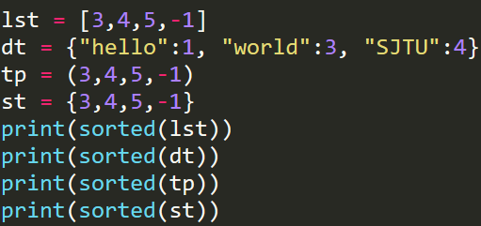
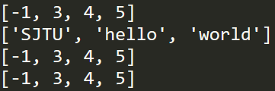
sorted: 排序
Python lists have a built-in list.sort() method that modifies the list in-place. There is also a sorted() built-in function that builds a new sorted list from an iterable.
sorted(x): 对x排序并return新的list变量
list.sort(): 对列表排序，无返回值
https://docs.python.org/3/howto/sorting.html

Slide 13
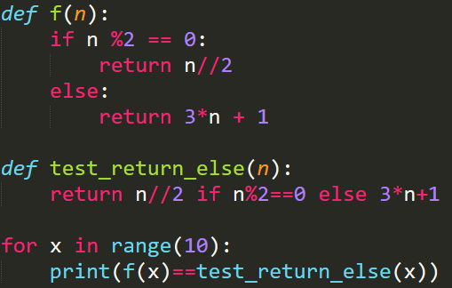

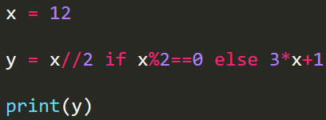
return … if … else …
return value1 if condition else value2
A convenient usage of return
Equivalent
if condition:
return value1
else:
return valuel2

Slide 14
for/while - else
for/while loops also have an else clause which most of us are unfamiliar with.
The else clause executes after the loop completes normally.
This means that the loop did not encounter a break statement.
The common construct is to run a loop and search for an item.
If the item is found, we break out of the loop using the break statement. There are two scenarios in which the loop may end.
The first one is when the item is found and break is encountered.
The second scenario is that the loop ends without encountering a break statement.
Now we may want to know which one of these is the reason for a loop’s completion.
One method is to set a flag and then check it once the loop ends. Another is to use the else clause.
https://book.pythontips.com/en/latest/for_-_else.html

Slide 15
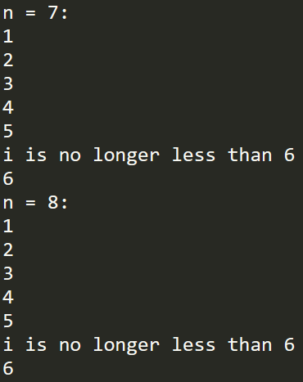
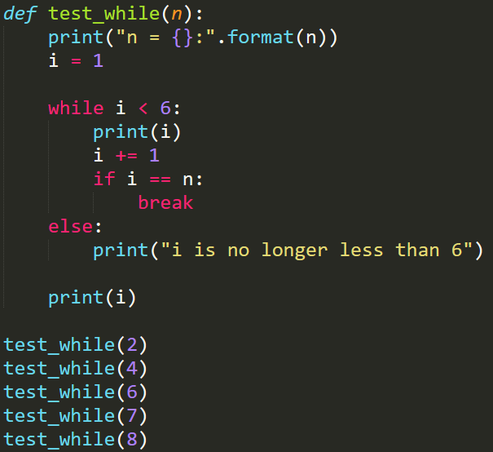
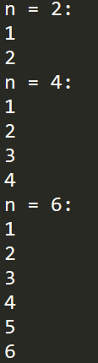
如果不用else：
在循环结束后加一个判断：if i==6

Slide 16
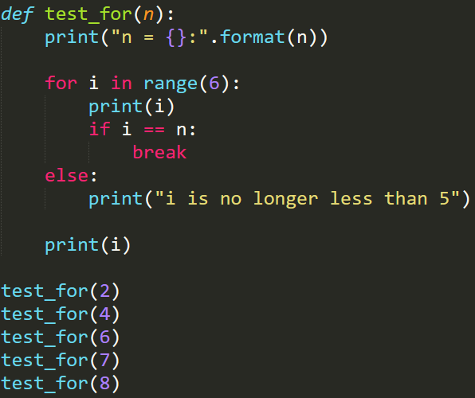
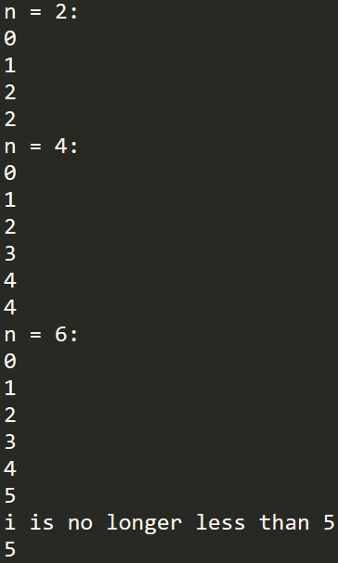
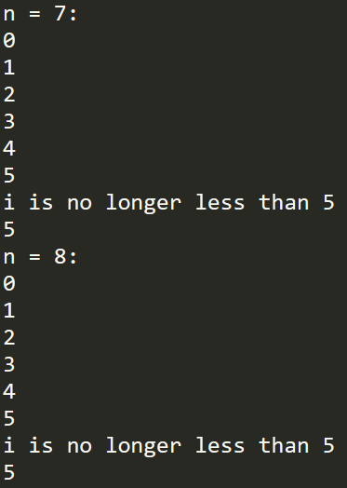
不要用没有完全掌握的语法
如果不用else：
在循环结束后加一个判断
for要注意，结束的情况和while不同

Slide 17
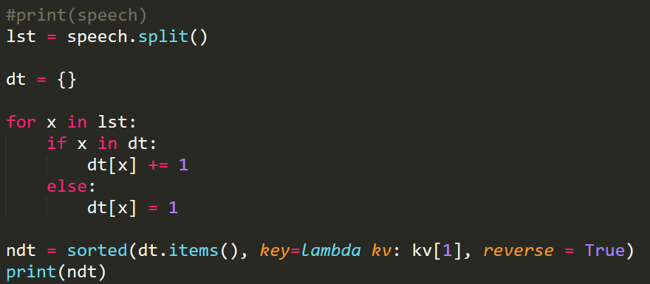
Dict应用：统计数量
Dict的结构中key:value, 其中value可用来保存有用的信息，譬如数量
给定一篇文章，统计每个单词出现的数量
http://en.sjtu.edu.cn/about-sjtu/presidents-welcome
speech = '''
Welcome to Shanghai Jiao Tong University!
Established in 1896 as Nan Yang College, Shanghai Jiao Tong University is one of the first
……
President of Shanghai Jiao Tong University
'''

Slide 18
基本函数: return VS in-place
Set.add
Set.union
List.append()

Slide 19
set vs. dict
它们的key都必须是immutable.
list不可以为dict的key，也不可以为set的元素
访问元素速度非常快，和查字典一样
set比dict功能少，更轻便
dict可以统计key的数目
Dictionaries and sets use hash tables in order to achieve their O(1) lookups and insertions. This efficiency is the result of a very clever usage of a hash function to turn an arbitrary key (i.e., a string or object) into an index for a list. The hash function and list can later be used to determine where any particular piece of data is right away, without a search. By turning the data’s key into something that can be used like a list index, we can get the same performance as with a list. In addition, instead of having to refer to data by a numerical index, which itself implies some ordering to the data, we can refer to it by this arbitrary key.
https://www.oreilly.com/library/view/high-performance-python/9781449361747/ch04.html

Slide 20
多行注释
# 单行
# + 三”/’的字符串:三对单引号

Slide 21
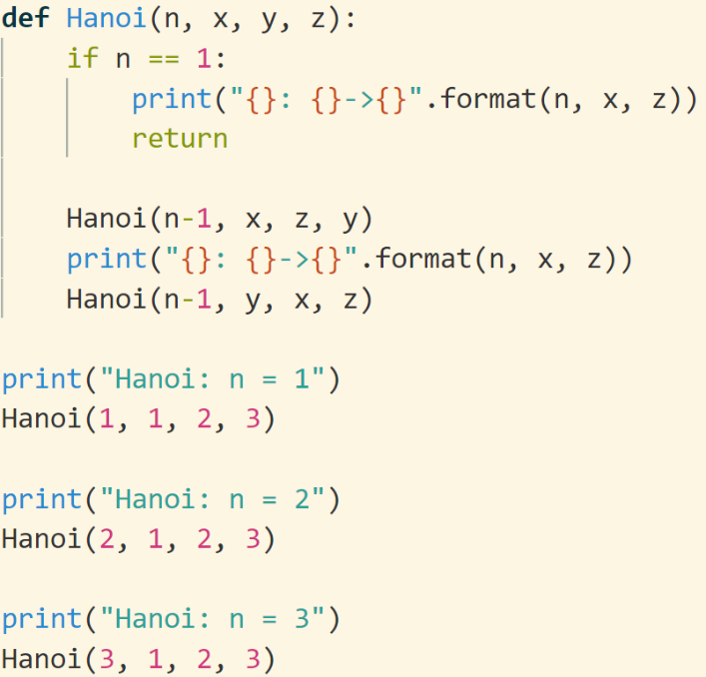
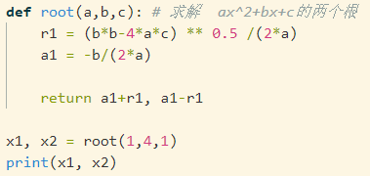
return
return的基本用法，参考return详解
return xxxx
xxx可以为空，表明结束函数调用，但是没有返回值。（方便写程序，不用if反复判断，干净利落）
xxx是一个对象，所以可以返回一个list, str, tuple, dict, set等等等等
习惯上，当有多个对象要一起返回时，打包成一个tuple: return x,y,z,…..
Packing and unpacking
思想不要僵化

Slide 22
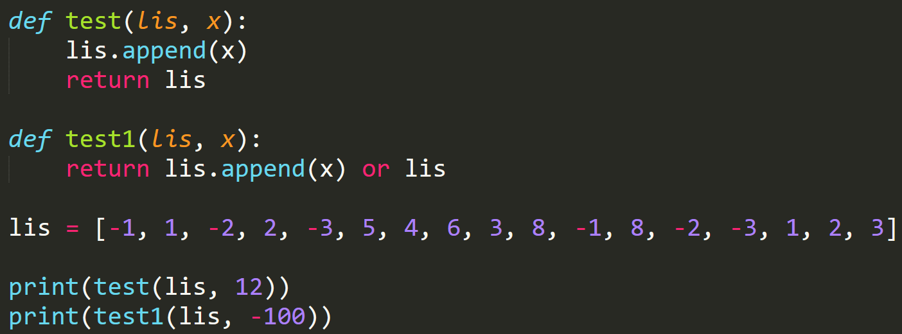
如何return返回值为None的函数的对象
List.append()/set.add()不会返回对象，而是对对象的修改
return list.append()/set.add(): 返回None
list.append()/set.add()
return list/set
return list.append() or list
逻辑表达式的值
不要用不熟悉的语法
发现古怪异常的时候，一定是你的知识点有错

Slide 23
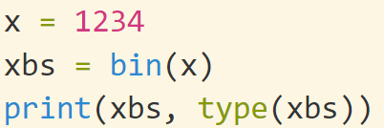
bin()
The bin() method converts and returns the binary equivalent string of a given integer.

Slide 24
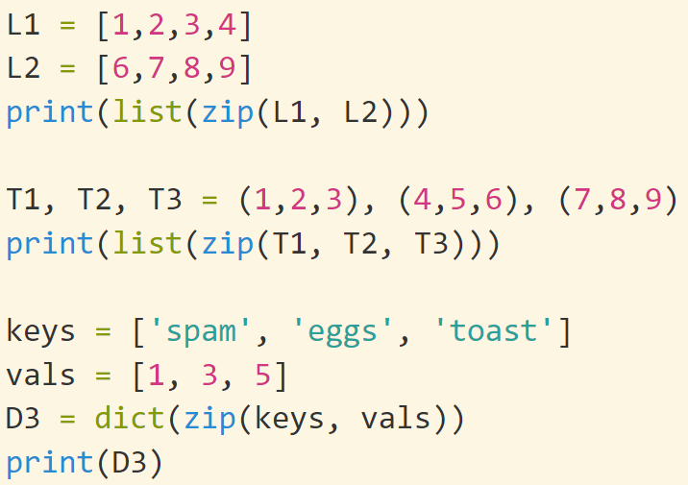
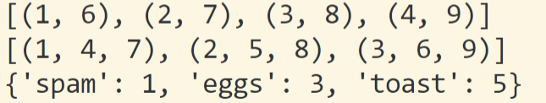
zip()
将n个list按元素合并为一个新list: 每个元素都是n维的

Slide 25
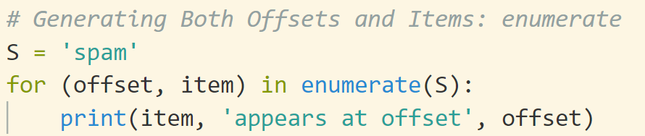
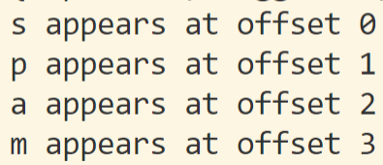
enumerate()
Generating both offsets (元素的序号) and items: enumerate

Slide 26
Built-in function内置函数
Python中有很多内置函数，实现了很多基本功能
一个经验是：如果你要实现一个基本功能，很可能python已经提供了
https://docs.python.org/3/library/functions.html
如何找内置函数：
搜索 python+关键词
譬如
查找一个集合的最大元素 max(collection_a)
求和 sum: lst = [1,2,3,4] sum(lst)

Slide 27
eval
eval可以用来计算一个字符串形式的表达式的值
eval(“123+456”)
返回值是表达式的值
eval完整的功能要强大很多: It is an interesting hack/utility in Python which lets a Python program run Python code within itself.
The eval() method parses the expression passed to it and runs python expression(code) within the program.
譬如eval可以将一个字符串形式的list，转换为list
lst = eval(“[1,2,3,[1,2,3]]”)
计算一般的表达式
x= 1 y =2 z=eval(“(x+1)**y+y”)
program = input('Enter a program:')
eval(program) #[print(item) for item in [1, 2, 3]]
Error: eval(“a=1”)
https://www.programiz.com/python-programming/methods/built-in/eval
https://www.geeksforgeeks.org/eval-in-python/

Slide 28


exec()
The exec() method executes the dynamically created program, which is either a string or a code object.
Return none
program = input('Enter a program:’)
exec(program) #[print(item) for item in [1, 2, 3]]
https://www.programiz.com/python-programming/methods/built-in/exec
https://stackoverflow.com/questions/2220699/whats-the-difference-between-eval-exec-and-compile

Slide 29
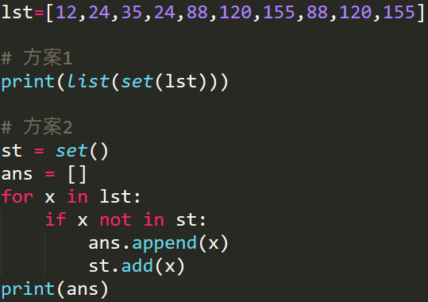

有序集、无序集
Python里面有些数据结构是有序的，可以排序：list, string
set(), dict()是无序的，一般情况下不可以排序，除非自己定义
With a given list [12,24,35,24,88,120,155,88,120,155], write a program to print this list after removing all duplicate values with original order reserved.

Slide 30
Tuple
Unpacking and packing可以嵌套
((a, b), c) = ((1, 2), 3)

Slide 31
List: Remove an Item
Remove an item from a list in Python (clear, pop, remove, del)
Remove all items: clear()
Remove an item by index and get its value: pop()
Remove an item by value: remove()
Remove items by index or slice: del.
Remove multiple items that meet the condition: List comprehensions.

Slide 32
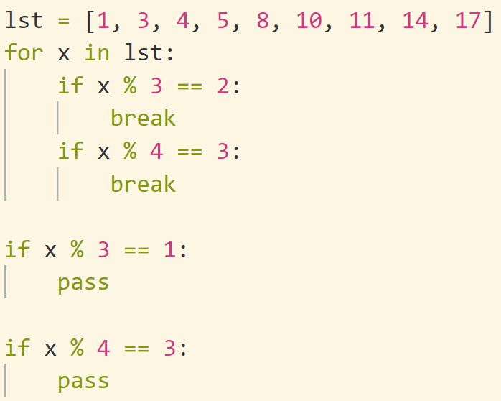
Loop在编程中的意义
遍历一个集合的元素
根据循环结束时各个变量的状态，判断现在程序的状态，执行下一阶段的命令 (合理利用程序运行中各种信息)
利用循环结束时x的状态，进行下一步操作

Slide 33
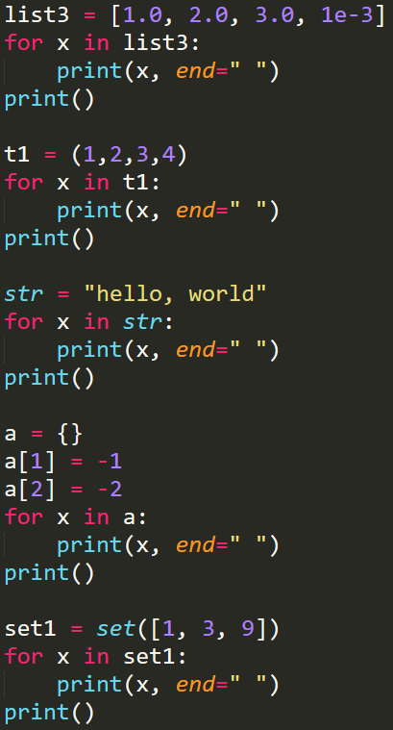
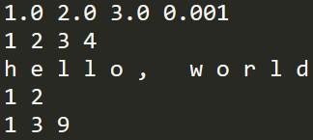
for的一般用法
for x in collection_a:
do_sth()
The type of collection_a could be list, tuple, dict, string, set, etc.
for 可以遍历一个合集

Slide 34
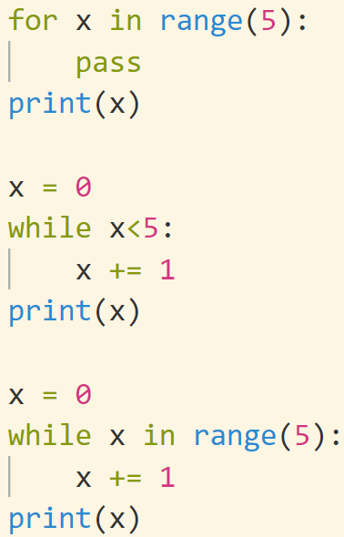

for VS while: 结束状态
for x in xxx 结束时，x时xxx中最后一个元素
while x in range(n): 结束时，x=n

Slide 35
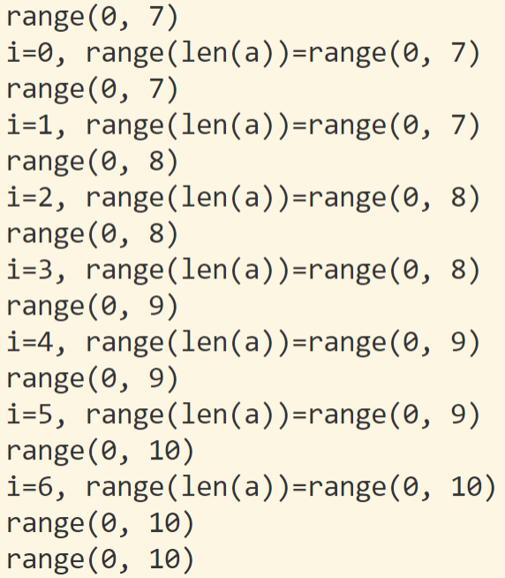
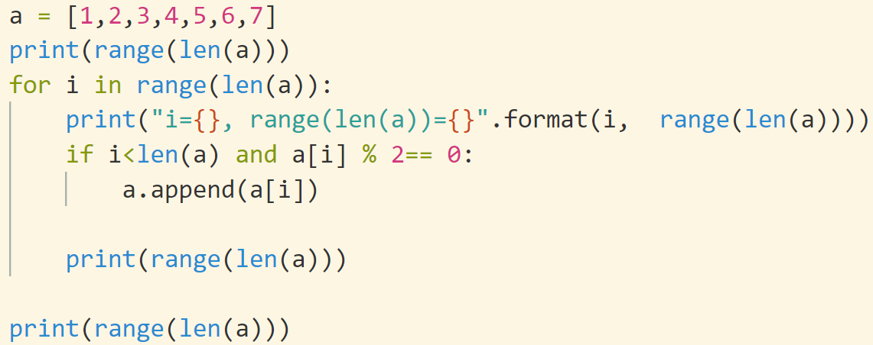
for x in collection_a: 状态不变
当for开始运行时，x的遍历序列就定义好了。
改变x不会改变collection_a
改变x不会改变x的遍历序列
i=0, 1, …, 6不变

Slide 36
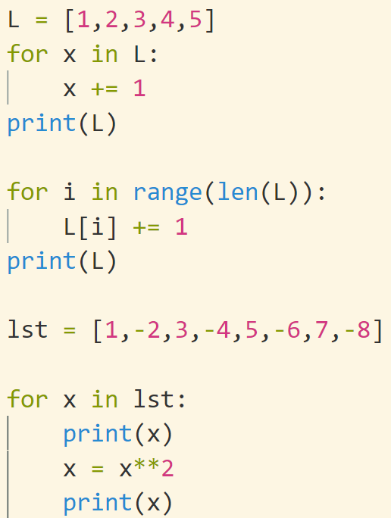
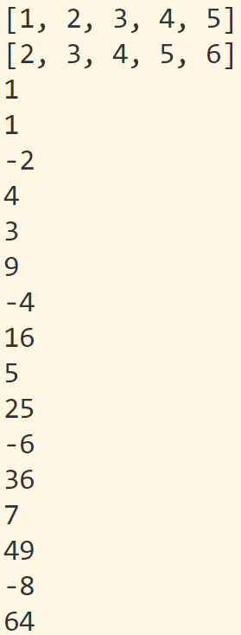

Slide 37
for x in collection_a:
for的陷阱: 应对
Code that modifies a collection while iterating over that same collection can be tricky to get right.
for内部的循环机理实现需要定义iter() (高级议题，后面讲到)
尽量不要一边修改集合collection_a, 一边进行for x in collection_a操作
在for x in xxx: do_sth()
do_sth()对x的修改并不改变x的遍历顺序
for和range结合的时候也有这种现象
解决思路：
用while 手工操作
用集合collection_a.copy()来处理
用for x in reversed(lst):
列表推导
https://docs.python.org/3/tutorial/controlflow.html#for-statements
https://sopython.com/canon/95/removing-items-from-a-list-while-iterating-over-the-list/

Slide 38
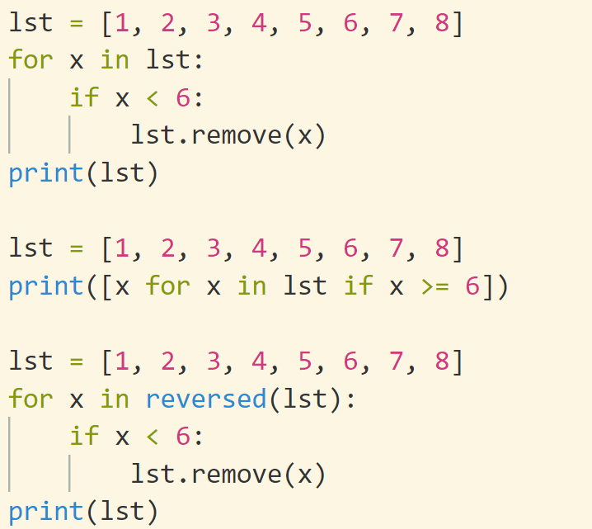
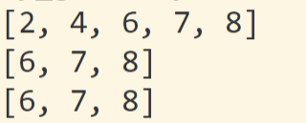
血泪教训：for 和remove尽量不要一起用
特别注意：不要一边修改一个数据结构，一边遍历它，否则遍历的顺序可能会很古怪

Slide 39
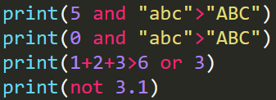

Boolean expression
The following values are interpreted as false: False, None, numeric zero of all types, and empty strings and containers (including strings, tuples, lists, dictionaries, sets and frozensets). All other values are interpreted as true.
https://docs.python.org/3.8/reference/expressions.html#boolean-operations
Return value of Boolean expression
The expression x and y first evaluates x; if x is false, its value is returned; otherwise, y is evaluated and the resulting value is returned.
The expression x or y first evaluates x; if x is true, its value is returned; otherwise, y is evaluated and the resulting value is returned.
Note that neither and nor or restrict the value and type they return to False and True, but rather return the last evaluated argument. This is sometimes useful, e.g., if s is a string that should be replaced by a default value if it is empty, the expression s or 'foo' yields the desired value. Because not has to create a new value, it returns a boolean value regardless of the type of its argument (for example, not 'foo' produces False rather than ''.)

Slide 40
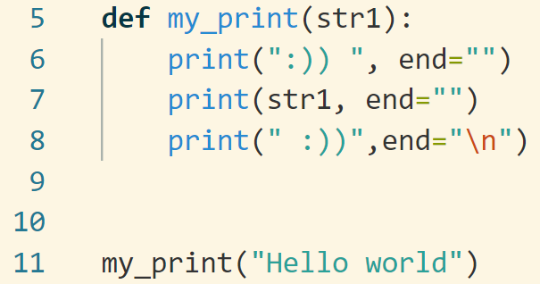
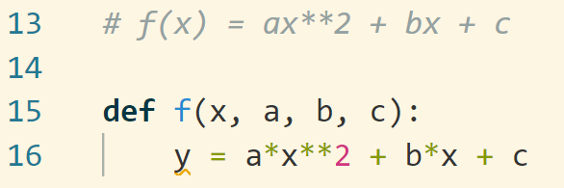
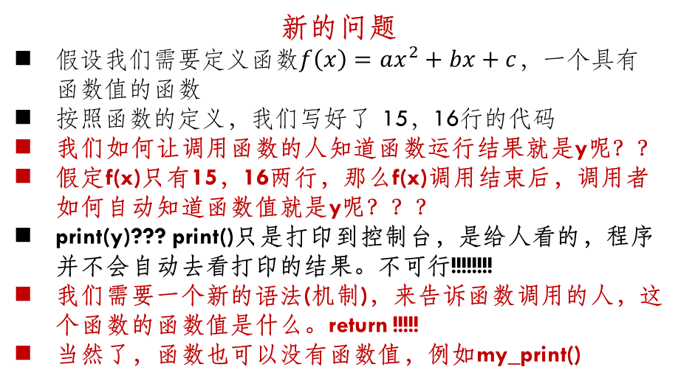
return详解 (1)
函数运行的基本规律
在函数调用中，程序执行的顺序会跳转到被调用函数中，然后依次运行被调用函数中的语句。
函数中的语句执行结束后，执行的顺序就回到调用的地方接着继续执行。
左边的程序，在运行到第11行时，程序跳转到第5行运行，依次运行到第8行，运行完后，回到第12行。
由于函数内部和外部互相不干扰，所以函数运行结束后，里面的变量和数据都”销毁”了
新的问题
假设我们需要定义函数$f\left(x\right)=ax^{2}+bx+c$，一个具有函数值的函数
按照函数的定义，我们写好了 15，16行的代码
我们如何让调用函数的人知道函数运行结果就是y呢？？
假定f(x)只有15，16两行，那么f(x)调用结束后，调用者如何自动知道函数值就是y呢？？？
print(y)??? print()只是打印到控制台，是给人看的，程序并不会自动去看打印的结果。不可行!!!!!!!!
我们需要一个新的语法(机制)，来告诉函数调用的人，这个函数的函数值是什么。return !!!!!
当然了，函数也可以没有函数值，例如my_print()

Slide 41
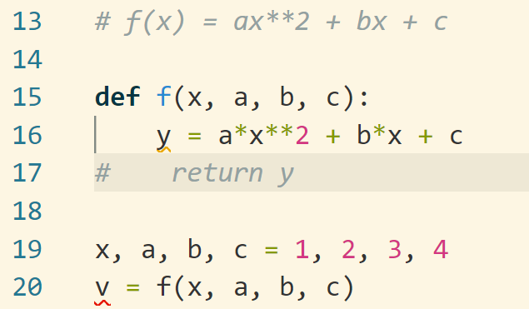
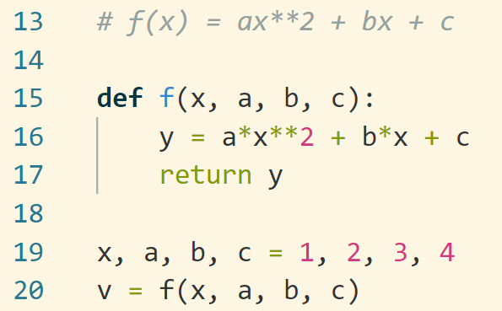

return详解 (2)
return
上面两个代码，左边没有return y，右边有return y
同样对于20行的f()函数调用, 左边的代码运行到16就返回了，不会告诉调用f的用户，函数值是y
右边的函数，通过return y命令告诉了用户，函数值为y
这样20行，右边就可以把y赋值给v了。
默认情况下，函数执行结束后，会返回到调用它的地方。如果没有返回值，可以默认返回None，即return None。None在python中表示不存在的意思
我们说没有返回值，等价于返回None。
Return vs Print()
Return是告诉调用者，函数的值是多少
Print是将信息输出到控制台，二者风马牛不相及

Slide 42
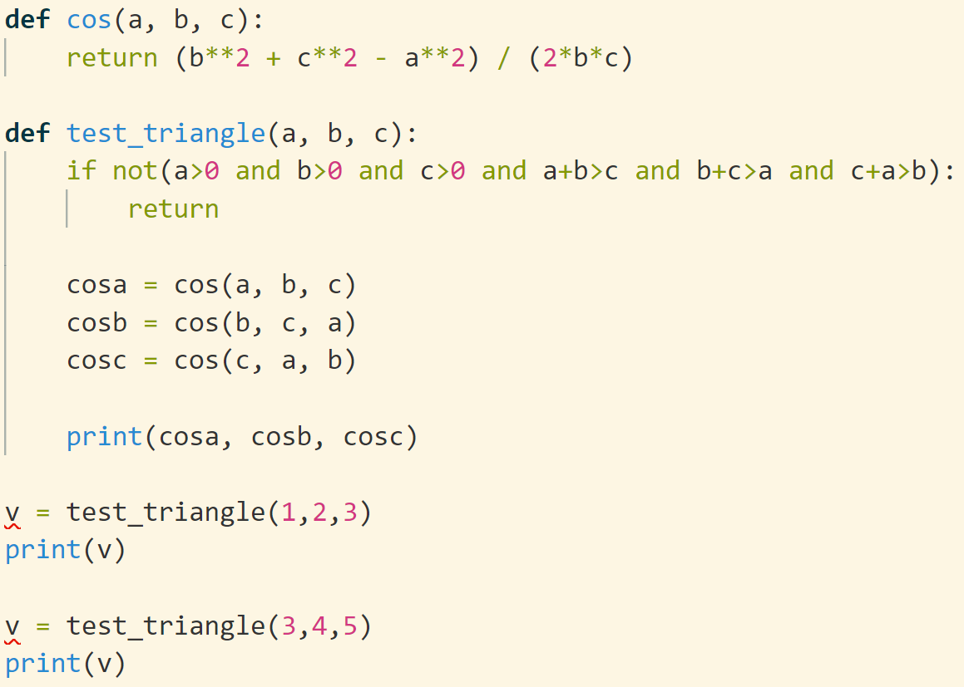
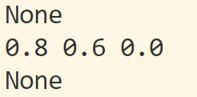
return详解 (3)

Slide 43
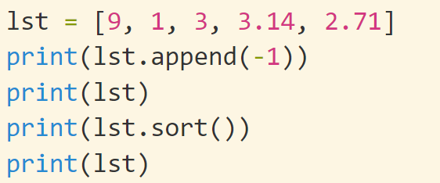
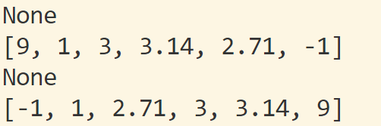
return详解 (4)
Python中的列表在设计时，append()和sort()函数是直接在原列表上修改，不会生成新的列表。所以不需要返回一个新的列表，也就没有返回值(等价于return None)。
print(lst.append(-1)) 和 print(lst.sort())都会输出None
但是lst在append和sort后，都已经发生了改变
假定有两个列表a, b，那么c=a+b将生成一个新的列表。生成新的和直接修改会有很多影响。

Slide 44
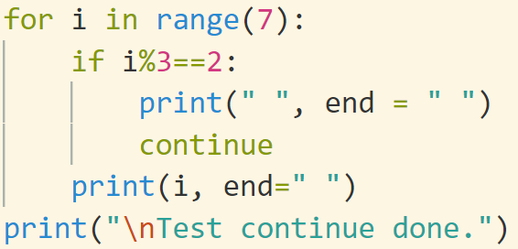





break, continue, return
break: 结束整个循环
continue：结束本轮循环，开始下一轮
return: 结束函数运行，返回

Slide 45


+=, /=, *=
In python, when you write an expr like a = a + b, you may just write it as a += b
+=, -=, *=, /=, //=
However, you should pay attention to the situations when a is mutable: list, dict
不可被修改
基本类型：int, float, complex
数据结构: tuple, string
(不可修改，情况会简单很多)
可被修改
list
dict
set
自定义复合类型
特别注意区别
创造新变量
改造旧变量
赋值、参数传递特别注意

Slide 46


Mutability of parameters
参数传递的过程就是个赋值语句：
参数1 = 表达式1 ，参数2 = 表达式2，……
如果表达式是一个可修改类型，那么函数可以在内部修改传递表达式
a: 基本int类型，不可修改。
b: 是list，可以被修改。
参数传递：
inta = a
listb = b
修改listb就修改了b
If a mutable parameter is passed into a function, it may be altered inside the function

Slide 47








*args
此页**kwargs仅供了解，不做要求
If * appeared before a function parameter, then it can accept any number of variables. (In convention, we use * args)
KWargs or “keyword arguments” allows you to pass the keyworded dictionary as arguments.

Slide 48

Built-in functions
The Python interpreter has a number of functions and types built into it that are always available. They are listed here in alphabetical order.
https://docs.python.org/3.8/library/functions.html
Tips: 当你需要实现一个基本的功能的时候，python可能已经帮你实现了

Slide 49
How to program
For most PLs like C++, Java, Python, etc..
Basic grammar structure (语句的意义 + 语句的语法)
Data types: inter, float, string
Expression: arithmetic, logic
Conditional expression
Loops
Advanced
Files
Class
Standard library
Complicated Hard
There are thousand methods to implement a feature
╳
Practice makes perfect

